Slide 1

Revenue Analysis Report
ATLIQ HOTELS
Leveraging Business Intelligence to drive strategic decisions in India's luxury hospitality market

Slide 2

The Problem Statement
AtliQ, with over 20 years in India's hospitality industry, faces declining revenue and market share in the luxury segment due to increased competition and ineffective decision-making.
20+
Years Operating
The management seeks to leverage Business Intelligence and Data Analytics to identify performance gaps and implement data-driven strategies for recovery.
5★
Hotel Category

Slide 3
Analysis Goals
01
02
03
Evaluate Performance
Identify Trends
Generate Insights
Assess business performance using key hospitality metrics
Analyze patterns across time, cities, properties, and booking platforms
Deliver actionable recommendations to improve revenue and efficiency
Key metrics examined: Revenue, Occupancy, RevPAR, ADR, DBRN, DSRN, DURN, Cancellation Rate, Realisation %, and Customer Review Ratings

Slide 4
Overall Business Performance
₹1.69B
57.8%
₹12.7K
₹7,337
Total Revenue
Occupancy Rate
Average Daily Rate
RevPAR
Moderate utilization
Room for improvement
24.8%
70.1%
3.62
Cancellation Rate
Realisation Rate
Review Rating
High impact on revenue
Acceptable satisfaction

Slide 5
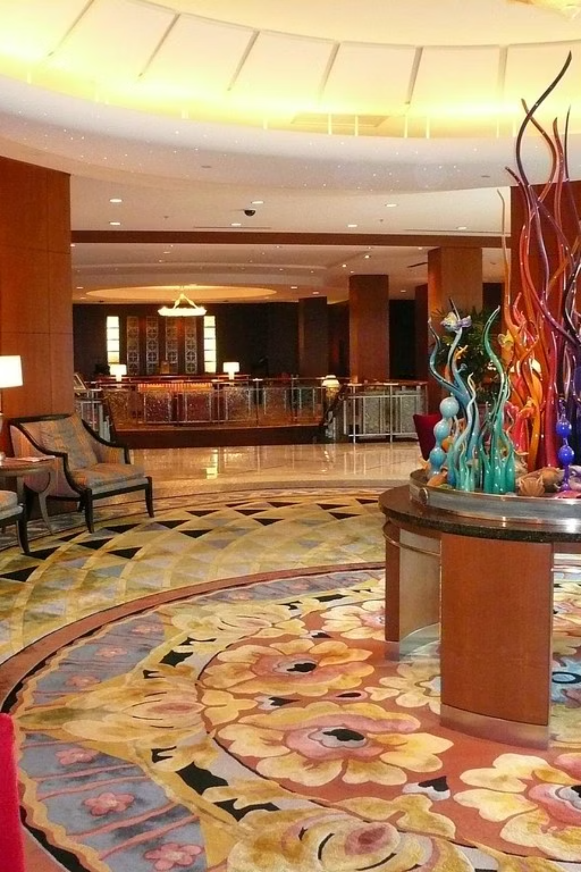

Weekend vs Weekday Performance
Weekend Performance
Weekday Performance
Occupancy: 62.6%
Occupancy: 55.8%
RevPAR: ₹7,972
RevPAR: ₹7,337
ADR: ₹12,725
ADR: ₹12,700
Realisation: 70.6%
Realisation: 69.9%
Weekends clearly outperform weekdays with stronger demand and better pricing power across all key metrics

Slide 6
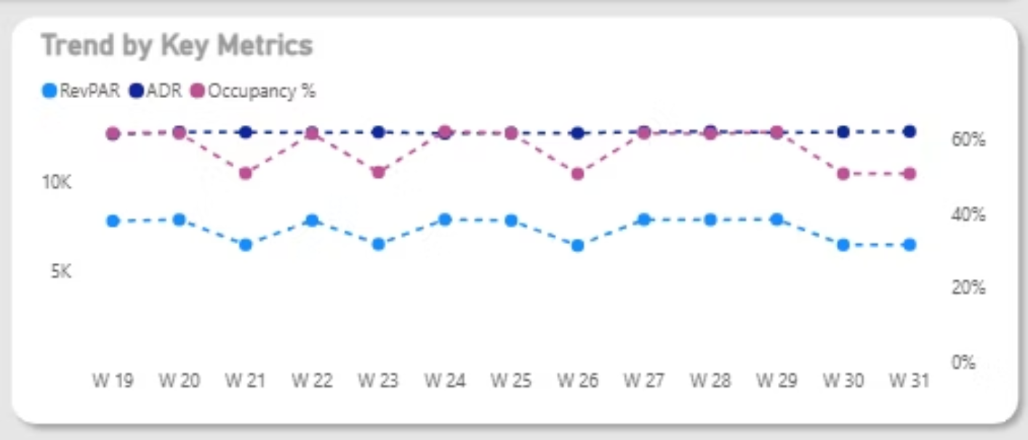
Month-wise & Week-wise Trends
May 2022
July 2022
₹582M revenue with 58.5% occupancy - highest performance due to vacation period
₹552M revenue - stable ADR maintained
1
2
3
June 2022
₹554M revenue - gradual decline begins
Weekly Pattern Observed
High weeks: Weeks 19, 20, 22, 24, 27-29 show ₹139-140M revenue with 61%+ occupancy
Low weeks: Weeks 21, 23, 26, 30-31 dip to ~51% occupancy and ₹114-115M revenue

Slide 7
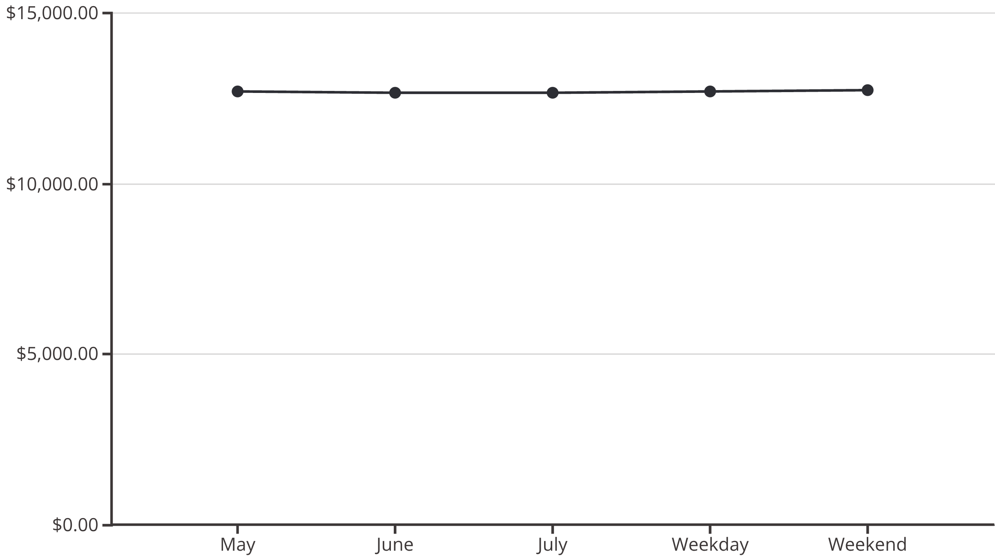
ADR Analysis: Static Pricing Challenge
Remarkable Stability
Missed Opportunities
ADR remains consistently at ₹12.6K-₹12.7K across all periods, indicating a fixed pricing strategy
Static pricing fails to capitalize on high-demand periods like weekends and peak weeks

Slide 8
Booking Platform Performance
70.6%
70%+
69.8%
Logtrip
Journey & Direct Online
Tripster & Makeyourtrip
Highest realisation with ₹12,705 ADR - most efficient channel
Consistent performance with strong realisation rates
Lower realisation indicating higher cancellations
Direct and premium platforms deliver better quality bookings with higher conversion rates

Slide 9


Property & City Performance
Top Properties
City Leaders
₹661M
60.4%
AtliQ Exotica
Mumbai
Delhi
₹316M revenue, 70.6% realisation
Highest revenue, ₹15.38K ADR
Highest occupancy, 3.78 rating
70.3%
AtliQ Palace
Hyderabad
₹300M revenue, 59.9% occupancy
Best realisation, lowest cancellations
Bangalore shows challenges with 55.7% occupancy and 3.41 rating - lowest among all cities
AtliQ City
₹282M revenue, 59.4% occupancy
Underperformers
AtliQ Seasons: ₹65M revenue, 44.6% occupancy, 2.30 rating
AtliQ Grands: ₹209M revenue, 52.5% occupancy, 25.1% cancellations

Slide 10
Strategic Recommendations
Dynamic Pricing Strategy
1
Implement demand-based pricing to optimize ADR during high-demand weekends and peak weeks
Property Improvement Focus
2
Conduct root-cause analysis for AtliQ Seasons and AtliQ Grands, prioritizing guest experience and review ratings
Channel Optimization
3
Focus marketing and inventory allocation toward high-realisation platforms like Logtrip and Direct channels
Demand Smoothing
4
Introduce targeted promotions during low-occupancy weeks to reduce revenue fluctuations
Guest Experience Enhancement
5
Improve service quality to boost ratings, directly enhancing platform ranking and conversion rates

